Slide 1
CSE1201: Object Oriented Programming-I (C++)
Lecture 4

Slide 2
Outline
Primitive Data Types of C++
Operators in C++
Decision Making and Branching
Repetition Statements
C++ comments

Slide 3
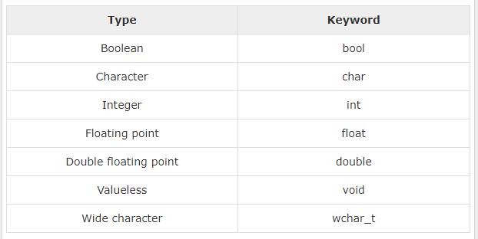
The Primitive Data Types of C++

Slide 4
The Primitive Data Types
Several of the basic types can be modified using one or more of these type modifiers −
signed
unsigned
short
long

Slide 5
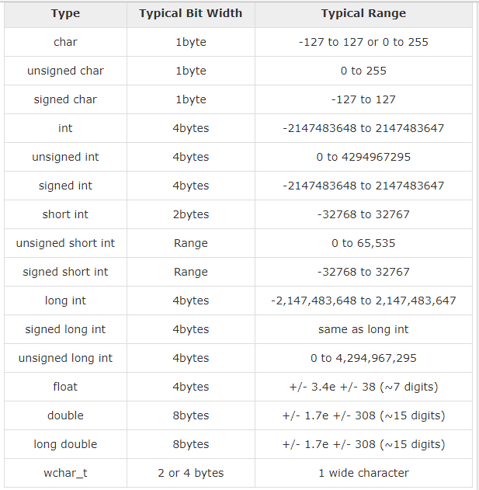
The Primitive Data Types

Slide 6
The Primitive Data Types
#include <iostream>
using namespace std;
int main()
{
cout << "Size of char : " << sizeof(char) << endl;
cout << "Size of int : " << sizeof(int) << endl;
cout << "Size of short int : " << sizeof(short int) << endl;
cout << "Size of long int : " << sizeof(long int) << endl;
cout << "Size of float : " << sizeof(float) << endl;
cout << "Size of double : " << sizeof(double) << endl;
cout << "Size of wchar_t : " << sizeof(wchar_t) << endl; return 0;
}

Slide 7
Booleans
Size is 1 byte – two value: true and false.
This type is returned by all relational operators.
Example:
bool b;
b= true;
cout << “b is ”<<b;
Output:
b is 1

Slide 8
Wide Character
A wide character is a character datatype that generally has a size greater than the traditional 8-bit character
The increased datatype size allows for the use of larger coded character sets
#include<iostream>
using namespace std;
int main() {
wchar_t wide_character = L 'a';
cout << "The wide character is: " << wide_character << endl;
cout << "Wide character size: " <<sizeof(wide_character);
}

Slide 9
Operators in C++
Arithmetic and Assignment Operator
Bitwise Operator
Relational Operator
Logical Operator

Slide 10
Arithmetic Operators
Addition
Subtraction
Multiplication
Division
Remainder
Increment
Addition Assignment
Subtraction Assignment
Multiplication Assignment
Division Assignment
Modulus Assignment
Decrement
+
-
*
/
%
++
+=
-=
*=
/=
%=
--

Slide 11
Arithmetic
Arithmetic calculations
* : Multiplication
/ : Division
Integer division truncates remainder
7 / 5 evaluates to 1
% : Modulus operator returns remainder
7 % 5 evaluates to 2
Oerator(s) | Operation(s) | Order of evaluation (precedence)
() | Parentheses | Evaluated first. If the parentheses are nested, the expression in the innermost pair is evaluated first. If there are several pairs of parentheses “on the same level” (i.e., not nested), they are evaluated left to right.
*, /, or % | Multiplication Division Modulus | Evaluated second. If there are several, they re-evaluated left to right.
+ or - | Addition Subtraction | Evaluated last. If there are several, they are evaluated left to right.

Slide 12
Arithmetic Operators
#include <iostream>
using namespace std;
int main()
{
int a = 21;
int b = 10;
int c ;
c = a + b;
cout << "Line 1 - Value of c is :" << c << endl ;
c = a - b;
cout << "Line 2 - Value of c is :" << c << endl ;
c = a * b;
cout << "Line 3 - Value of c is :" << c << endl ;
c = a / b;
cout << "Line 4 - Value of c is :" << c << endl ;
c = a % b;
cout << "Line 5 - Value of c is :" << c << endl ;
c = a++;
cout << "Line 6 - Value of c is :" << c << endl ;
c = a--;
cout << "Line 7 - Value of c is :" << c << endl ;
return 0;
}

Slide 13
Format Specifiers in C++
#include <iostream> // std::cout, std::endl
#include <iomanip> // std::setfill, std::setw
int main () {
std::cout << std::setfill ('x') << std::setw (10);
std::cout << 77 << std::endl;
return 0;
}
Output: xxxxxxxx77
#include <iostream> // std::cout, std::fixed, std::scientific
int main () {
double a = 3.1415926534;
double b = 2006.0;
double c = 1.0e-10;
std::cout.precision(5);
std::cout << "fixed:\n" << std::fixed;
std::cout << a << '\n' << b << '\n' << c << '\n';
return 0;
}
Output:
fixed:
3.14159
2006.00000
0.00000

Slide 14
Bitwise Operators
~ Bitwise unary NOT
& Bitwise AND
| Bitwise OR
^ Bitwise XOR
>> Shift Right
<< Shift left
& = Bitwise AND Assignment
|= Bitwise OR Assignment
^= Bitwise XOR Assignment
>>= Shift Right Assignment
<<= Shift Left Assignment

Slide 15
Bitwise Operator
Applied to integer types
A | B | A | B | A & B | A^ B | ~A
0 | 0 | 0 | 0 | 0 | 1
0 | 1 | 1 | 0 | 1 | 1
1 | 0 | 1 | 0 | 1 | 0
1 | 1 | 1 | 1 | 0 | 0

Slide 16
Bitwise Operator
#include <iostream>
using namespace std;
int main() {
// declaring two integer variables
int num = 212, i;
// Shift Right Operation
cout << "Shift Right:" << endl;
// Using for loop for shifting num right from 0 bit to 3 bits
for (i = 0; i < 4; i++) {
cout << "212 >> " << i << " = " << (212 >> i) << endl;
}
// Shift Left Operation
cout << "\nShift Left:" << endl;
// Using for loop for shifting num left from 0 bit to 3 bits
for (i = 0; i < 4; i++) {
cout << "212 << " << i << " = " << (212 << i) << endl;
}
return 0;
}

Slide 17
Relational operators
> greater than
>= greater than or equal to
< less than
<= less than or equal to
= = equal to
!= not equal to
The outcome of these operations is a Boolean value.
= = , != can be applied to any type

Slide 18
Boolean Logical Operator
|| Short-circuit OR
&& Short-circuit AND
! Logical unary NOT
A || B || C || D || E
A && B && C && D && E

Slide 19
Decision Making and Branching
When a program breaks the sequential flow and jumps to another part of the code, it is known as branching. When branching is done on a condition it is known as conditional branching.
Three decision making statements:
1. if statement
2. switch statement
3. conditional operator statement

Slide 20
The if Statement
The if statement has the following syntax:
The condition must be a boolean expression.
It must evaluate to either true or false.
if is a
reserved word
if (condition)
{
statement;
}
If the condition is true, the statement is executed.
If it is false, the statement is skipped.

Slide 21
The if-else Statement
An else clause can be added to an if statement to make an if-else statement
if ( condition )
{
statement1;
}
Else
{
statement2;
}
Statement x;
If the condition is true, statement1 is executed; if the condition is false, statement2 is executed
One or the other will be executed, but not both

Slide 22
Example
#include <iostream>
using namespace std;
int main()
{
int a = 5;
int b = 20;
int c ;
if(a && b)
{
cout << "Line 1 - Condition is true"<< endl ;
}
if(a || b)
{
cout << "Line 2 - Condition is true"<< endl ;
}
/* Let's change the values of a and b */
a = 0;
b = 10;
if(a && b)
{
cout << "Line 3 - Condition is true"<< endl ;
}
else
{
cout << "Line 4 - Condition is not true"<< endl ;
}
if(!(a && b))
{
cout << "Line 5 - Condition is true"<< endl ;
}
return 0;
}

Slide 23
Nested if….else Statements
The if…else statement can be contained in another if or else statement.
if (test condition1)
{
if (test condition2)
statement-1;
else
statement-2;
}
else
statement-3;
statement-x;

Slide 24
Multiway Selection: else if
Sometime you want to select one option from several alternatives
if (conditon1)
statement1;
else if (condition2)
statement2;
else if (condition3)
statement3;
else
statement4;
conditon1
evaluated
true
statement1
false
conditon2
evaluated
true
statement2
false
conditon3
evaluated
true
statement3
false
statement4

Slide 25
Multiway Selection: else if
#include <iostream>
using namespace std;
int main()
{
int num;
cout<<"Enter an integer number between 1 & 99999: ";
cin>>num;
if(num <100 && num>=1)
{
cout<<"Its a two digit number";
}
else if(num <1000 && num>=100)
{
cout<<"Its a three digit number";
}
else if(num <10000 && num>=1000)
{
cout<<"Its a four digit number";
}
else if(num <100000 && num>=10000)
{
cout<<"Its a five digit number";
}
else
{
cout<<"number is not between 1 & 99999";
}
return 0;
}

Slide 26
The switch Statement
The switch statement provides another means to decide which statement to execute next
The switch statement evaluates an expression, then attempts to match the result to one of several possible cases
The expression of a switch statement must result in an integral type, meaning an int or a char
Each case contains a value and a list of statements
The flow of control transfers to statement associated with the first value that matches

Slide 27
The switch Statement
The general syntax of a switch statement is:
switch (expression) {
case value1:
statement-list1
case value2:
statement-list2
case value3:
statement-list3
break;
Default:
Statement;
Break;
}
switch
and
case
are
reserved
words
If expression
matches value2,
control jumps
from here

Slide 28
The switch Statement
Often a break statement is used as the last statement in each case's statement list
A break statement causes control to transfer to the end of the switch statement
If a break statement is not used, the flow of control will continue into the next case
Sometimes this can be appropriate, but usually we want to execute only the statements associated with one case

Slide 29
The switch Statement
// Program to build a simple calculator using switch Statement
#include <iostream>
using namespace std;
int main()
{
char oper;
float num1, num2;
cout << "Enter an operator (+, -, *, /): ";
cin >> oper;
cout << "Enter two numbers: " << endl;
cin >> num1 >> num2;
switch (oper)
{
case '+':
cout << num1 << " + " << num2 << " = " << num1 + num2;
break;
case '-':
cout << num1 << " - " << num2 << " = " << num1 - num2;
break;
case '*':
cout << num1 << " * " << num2 << " = " << num1 * num2;
break;
case '/':
cout << num1 << " / " << num2 << " = " << num1 / num2;
break;
default: // operator is doesn't match any case constant (+, -, *, /)
cout << "Error! The operator is not correct";
break;
}
return 0;
}

Slide 30
The Conditional Operator
C++ has a conditional operator that evaluates a boolean condition that determines which of two other expressions is evaluated
The result of the chosen expression is the result of the entire conditional operator
Its syntax is:
condition ? expression1 : expression2
If the condition is true, expression1 is evaluated; if it is false, expression2 is evaluated

Slide 31
The Conditional Operator
#include <iostream>
using namespace std;
int main () {
// Local variable declaration:
int x, y = 10;
x = (y < 10) ? 30 : 40;
cout << "value of x: " << x << endl;
return 0;
}

Slide 32
Repetition Statements
Repetition statements allow us to execute a statement multiple times
Often they are referred to as loops
Like conditional statements, they are controlled by boolean expressions
C++ has three kinds of repetition statements:
the for loop
the while loop
the do while loop
The programmer should choose the right kind of loop for the situation

Slide 33
The for Loop
The for loop has the following syntax:
The initialization
is executed once
before the loop begins
The statement is
executed until the
condition becomes false
Reserved
word
for (initialization; condition; increment)
statement;
The increment portion is executed at the end of each iteration
The condition-statement-increment cycle is executed repeatedly

Slide 34
Logic of a for loop
initialization
condition
evaluated
true
false
statement
increment

Slide 35
for Loop Example
#include <iostream>
using namespace std;
int main()
{
// The loop goes while x < 10, and x increases by one every loop
for ( int x = 0; x < 10; x++ ) {
cout<< x <<endl;
}
}

Slide 36
The while Loop
The while loop has the following syntax:
initialization;
while (condition)
statement;
increment/decrement;
while is a
reserved word
If the condition is true, the statement is executed.
Then the condition is evaluated again.
The statement is executed repeatedly until
the condition becomes false.

Slide 37
while Loop Example
#include <iostream>
using namespace std;
int main()
{
int x = 0; // Don't forget to declare variables
while ( x < 10 ) { // While x is less than 10
cout<< x <<endl;
x++; // Update x so the condition can be met eventually
}
}

Slide 38
for vs while Loop
#include <iostream>
using namespace std;
int main() {
int number;
int sum = 0;
// take input from the user
cout << "Enter a number: ";
cin >> number;
while (number >= 0) {
// add all positive numbers
sum += number;
// take input again if the number is positive
cout << "Enter a number: ";
cin >> number;
}
// display the sum
cout << "\nThe sum is " << sum << endl;
return 0;
}

Slide 39
The do-while Loop
The do-while loop has the following syntax:
The statement is executed first time without checking the condition
and repeatedly until the condition becomes false.
initialization;
do {
statement;
} while (condition);
do is a
reserved word
If the condition is true, the statement is executed.
Then the condition is evaluated again.

Slide 40
do-while Loop Example
#include <iostream>
using namespace std;
int main() {
int number = 0;
int sum = 0;
do {
sum += number; // take input from the user
cout << "Enter a number: ";
cin >> number;
} while (number >= 0); // display the sum
cout << "\n The sum is " << sum << endl;
return 0;
}

Slide 41
Nested Loops
Similar to nested if statements, loops can be nested as well
That is, the body of a loop can contain another loop
Each time through the outer loop, the inner loop goes through its full set of iterations

Slide 42
Nested Loops
#include <iostream>
using namespace std;
int main () {
int i, j;
for(i = 2; i<100; i++)
{
for(j = 2; j <= (i/j); j++)
if(!(i%j))
break; // if factor found, not prime
if(j > (i/j))
cout << i << " is prime\n";
}
return 0;
}

Slide 43
Loop Control Statements
Loop control statements change execution from its normal sequence.
C++ supports the following control statements:
break statement Terminate the loop or switch statement and transfers execution to the statement immediately following the loop or switch
continue statement Causes the loop to skip the remainder of its body and immediately test its condition prior to reiterating

Slide 44
Loop Control Statements
break statement
The break keyword will immediately stop the execution of the loop
Execution resumes after the end of the loop
for ( int a = 0; a <= 10; a++ ) {
if ( a == 5 ) {
break;
}
cout << a << "is less than five" << endl;
}
Output: 0 is less than five
1 is less than five
2 is less than five
3 is less than five
4 is less than five

Slide 45
Loop Control Statements
continue statement
The continue keyword will immediately start the next iteration of the loop
The rest of the current loop is not executed
for ( int a = 0; a <= 10; a++ ) {
if ( a % 2 == 0 ) {
continue;
}
cout << a << "is odd" << endl;
}
Output: 1 is odd
3 is odd
5 is odd
7 is odd
9 is odd

Slide 46
Thank you

